Slide 1

NINTH EDITION
macroeconomics
RUDIGER DORNBUSCH
STANLEY FISCHER
RICHARD STARTZ

Slide 2
Chapter Eleven
Monetary and Fiscal Policy

Slide 3
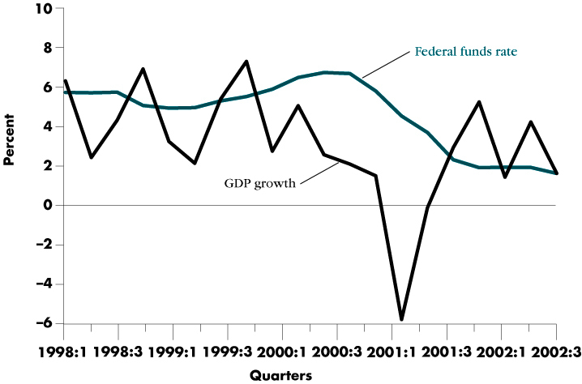
The 2001 Recession

Slide 4
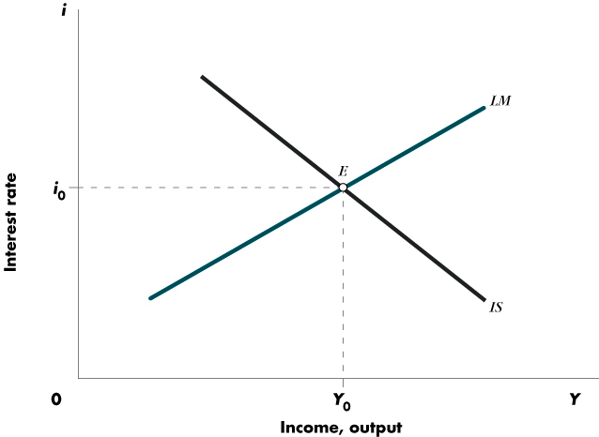
IS-LM Equilibrium

Slide 5
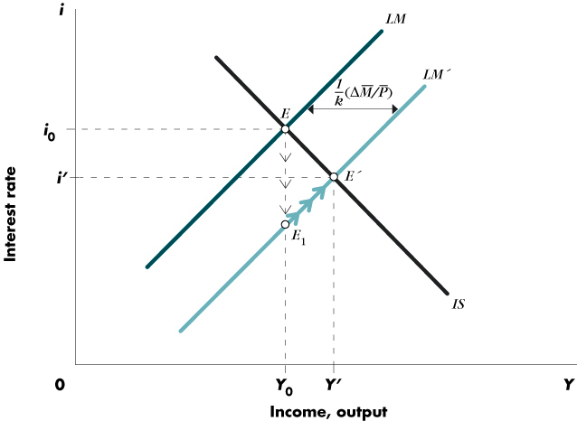
Monetary Policy

Slide 6
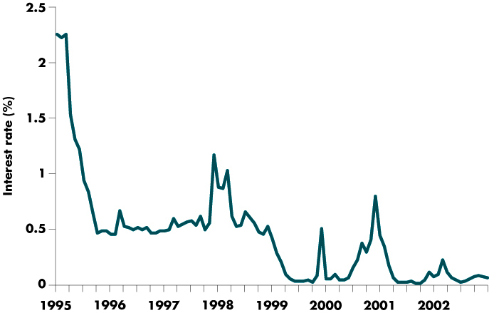
Japanese Interest Rates

Slide 7
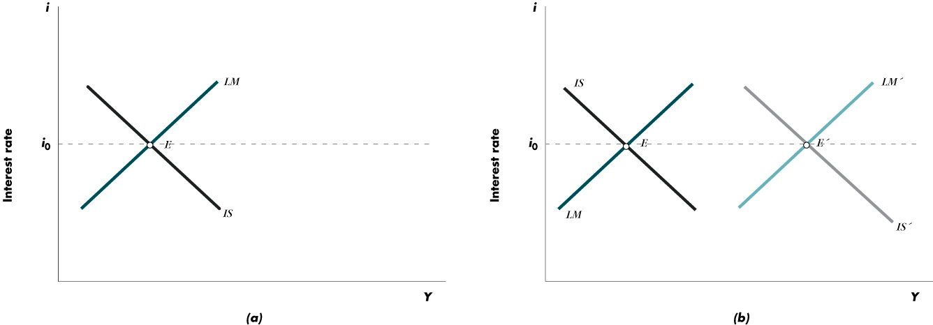
Pegging the Interest Rate

Slide 8
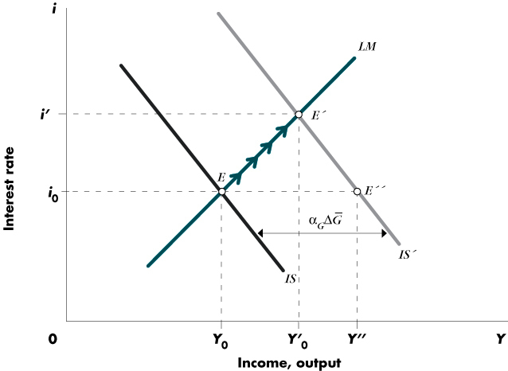
Effects of an Increase in
Government Spending

Slide 9
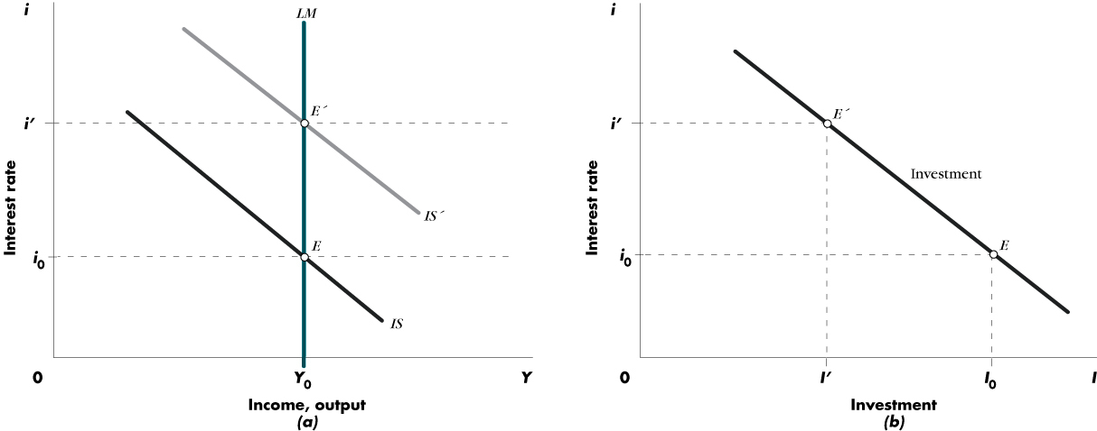
Full Crowding Out

Slide 10
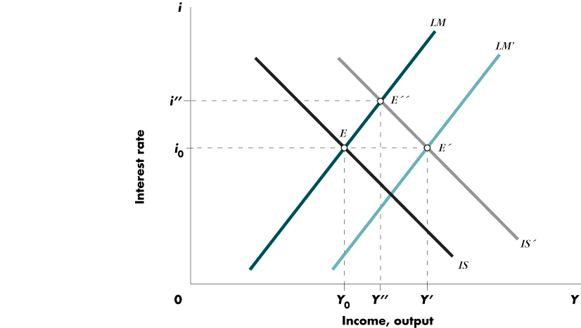
Monetary Accommodation of Fiscal Expansion

Slide 11
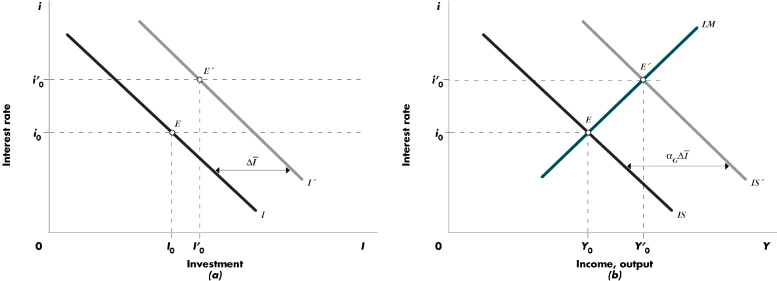
An Investment Subsidy Shifts the Investment Schedule

Slide 12
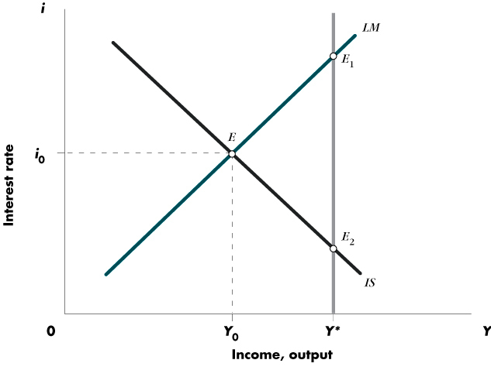
Expansionary Policies and the Composition of Output

Slide 13
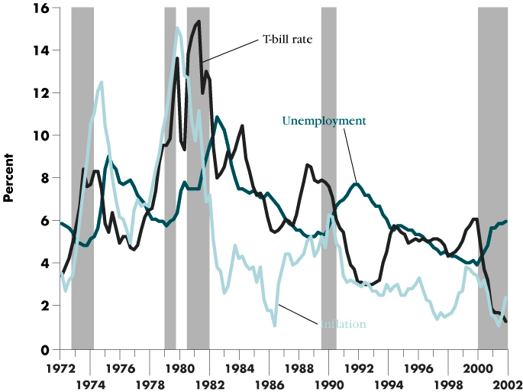
Inflation, Unemployment, and the Interest Rate

Slide 14
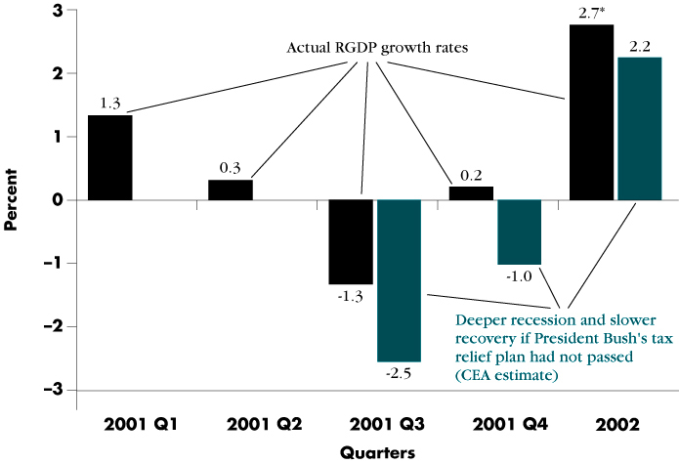
Real GDP Growth and President Bush’s Tax Relief

